Slide 1
Evolution – Part 2

Slide 2
Artificial Selection
Artificial Selection – when people select individuals to mate that have features they hope the offspring will inherit
  Also known as selective breeding
What are some examples?

Slide 3
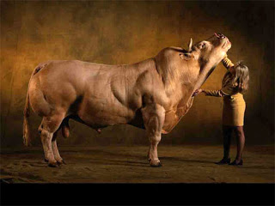

Slide 4
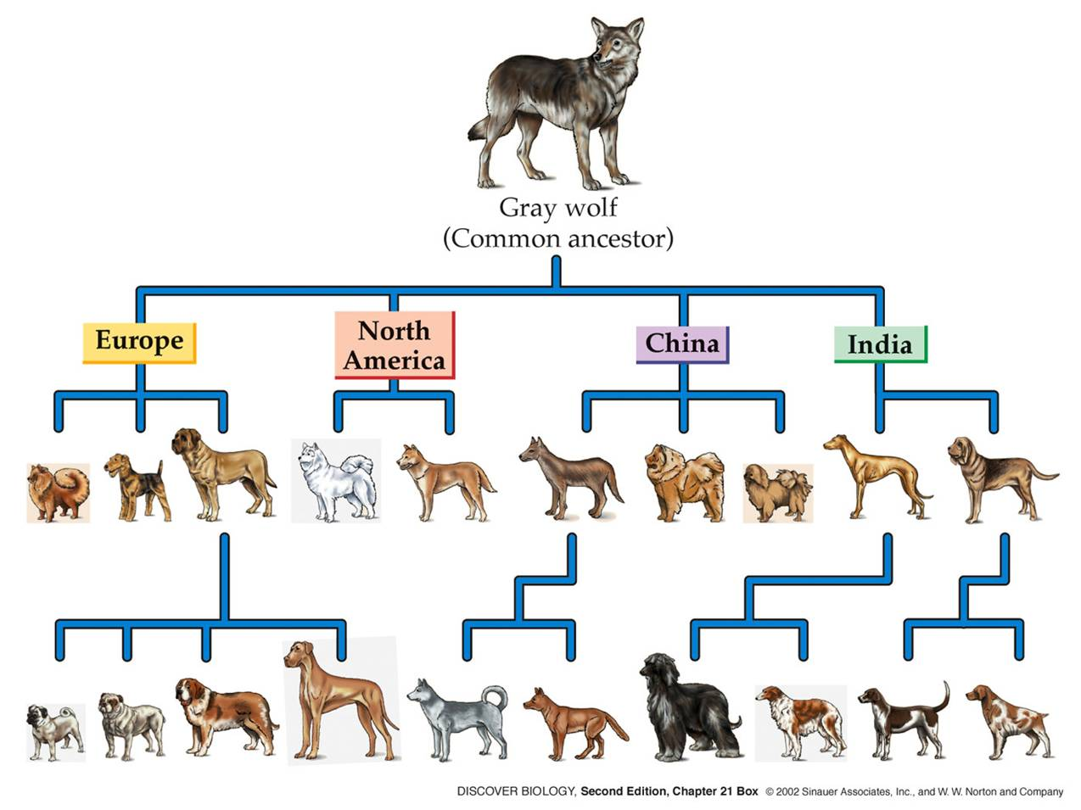

Slide 5
Artificial Selection and Dogs
All dogs belong to the same species - Canis familiaris
  Same species = they can mate!!
Contains about 400 different breeds
  Recognized dog breeds take generations to become established
  Many of the breeds we have today are the result of people wanting a dog with specific features
  What are some features or abilities of dogs that humans might artificially select for?

Slide 6
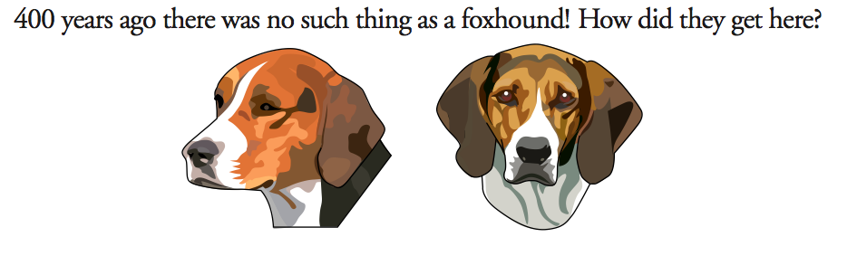
How to Get an American Foxhound and Why

Slide 7
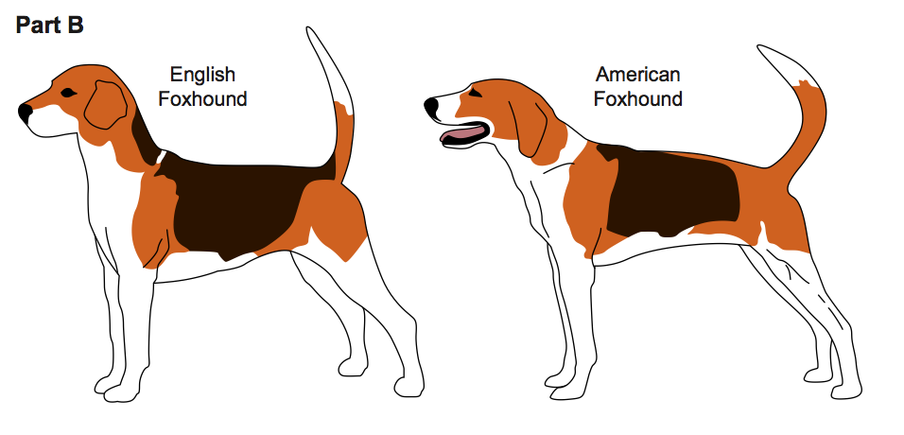
How to Get an American Foxhound and Why
Notes:
The American Foxhound is half descended from the English Foxhounds that were brought to American in 1650. The English hounds were crossed with a French hound that George Washington received as a gift from Lafayette. The combination breed became an excellent hunter of wild animals. The American Foxhound has great speed and an excellent sense of smell. It can run at high speeds for long periods and has a musical bark that is easy to follow. American Foxhounds are still used as hunting dogs today but are also used as companions and watchdogs.

Slide 8
Example
You want a dog that can hear a polar bear approaching and alarm the bear so that it will turn back.
Which of the following dogs would you selectively breed to produce off-spring that would be most effective in scaring away a polar bear?

Slide 9
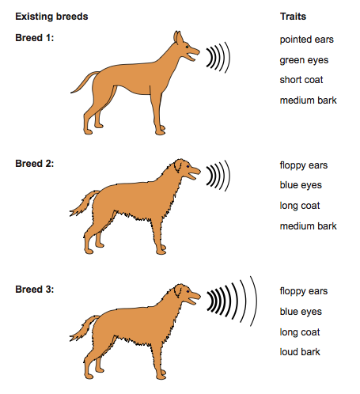

Slide 10
Anything else?
What other traits might be important to consider?
  Pointed ears?
  Loud bark?
  Long fur?
What traits might not be as important to consider?
  Eye color?
  Nose length?
  Tail length?

Slide 11
Dog Traits
Physical Traits
  Smell
  Sight
  Hearing
  Speed
  Endurance
  Strength
  Coat color
  Hair length
Behavioral Traits
  Trainability
  Disposition
  Bark
Significance
  Above average?
  Above average?
  Long/short, pointed/flat
  Long legs/short legs
  Large/small heart
  Large/small muscles
  Light/dark
  Long/short
  High/low
  Mean/nice
  Loud/quiet

Slide 12
Let’s make some dogs!
You and the members of your group are dog-breeders who will cross two breeds of dogs to artificially select a new dog with certain traits that are given to you by your client.
Discuss the types of features you think your new breed should have.
On the Ownership Card, circle the appropriate traits in Part 1. If the trait is unimportant, circle “Any”
Look at the Dog Breeds informational sheet and select two dog breeds to cross. Write the chosen breeds in Part 2 of your Ownership Card and your reasons why.

Slide 13
Let’s make some dogs!
Choose which breed will be the mother and which breed will be the father.
Mom and Dad are going to have 3 puppies!
What traits will the puppies inherit?
Heads = Mom’s trait
Tails = Dad’s trait
Flip the coin to determine each puppy’s trait and record on your Puppy Traits sheet.

Slide 14
Let’s see what they look like!
Each team member draws one of the puppies
  Team Member #1 – Puppy #1
  Team Member #2 – Puppy #2
  Team Member #3 – Puppy #3
Label the features the puppy inherited
Be able to explain which features were inherited

Slide 15
Let’s take a closer look
Were the puppies that your group bred identical?
Why or why not?
Were the puppies that the class bred identical?
Why or why not?

Slide 16
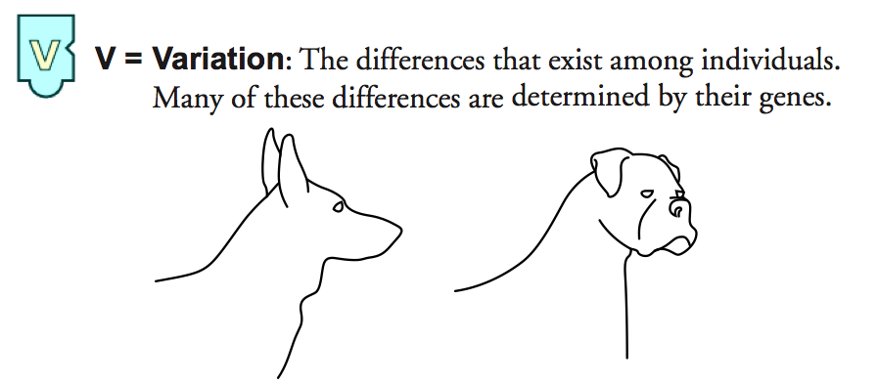
Artificial Selection Requires:

Slide 17
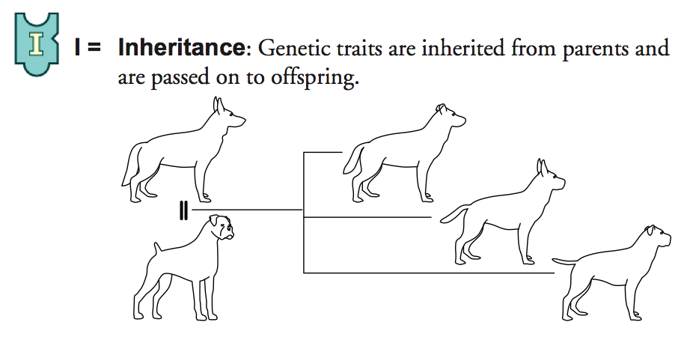
Artificial Selection Requires:

Slide 18
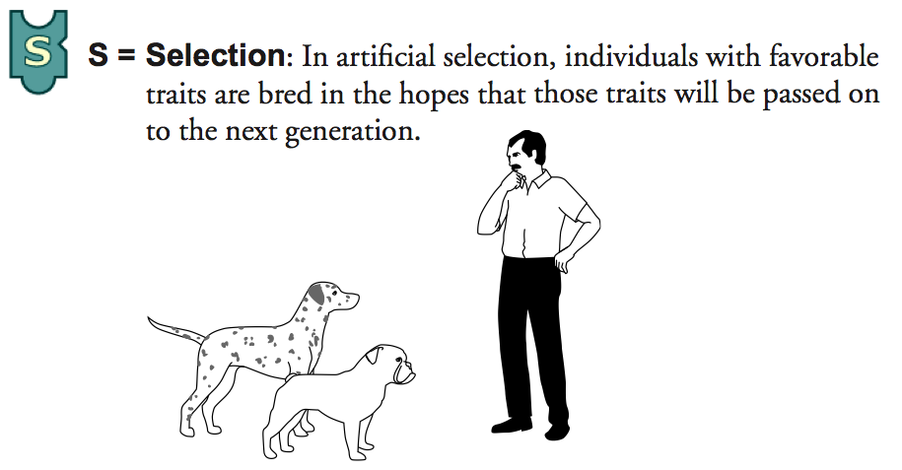
Artificial Selection Requires:

Slide 19
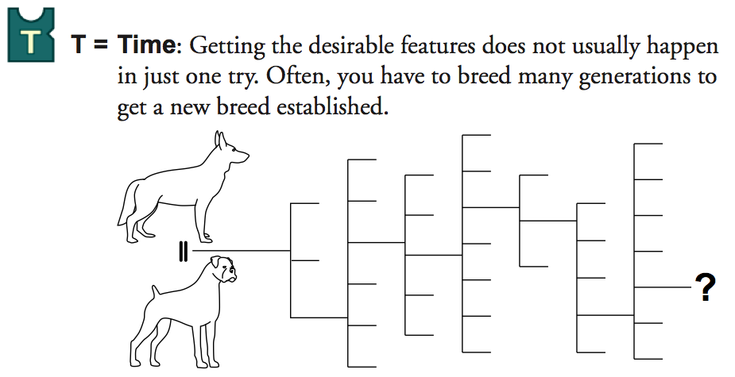
Artificial Selection Requires:

Slide 20
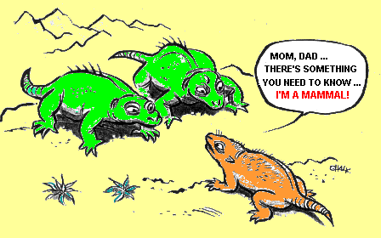
The Origin of Species

Slide 21
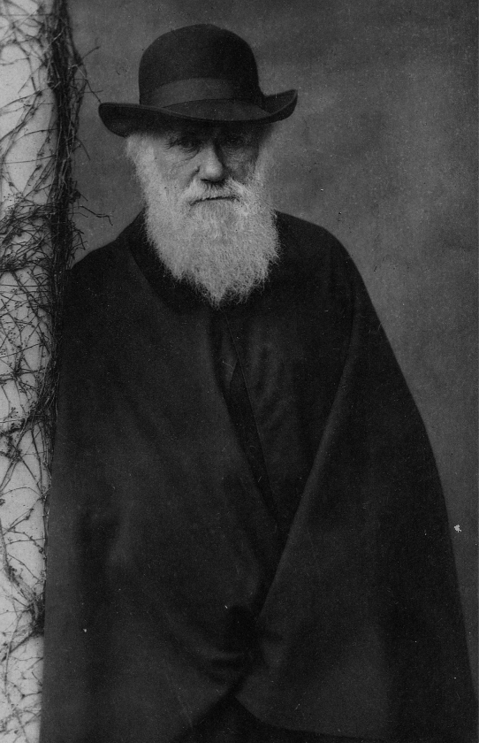
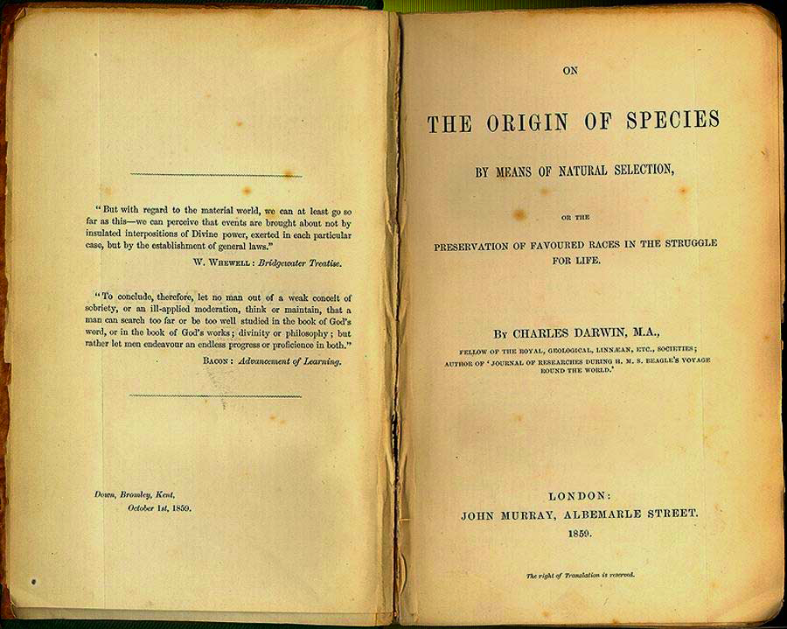
Remember…
Darwin never actually tackled how life originally came to be….
Both in space and time,
we seem to be brought
somewhat near to that great fact
—that mystery of mysteries—
the first appearance of
new beings on this Earth.
Notes:
Many questions remain concerning how long it takes for new species to form, or how many genes need to differ between species
Animation: Macroevolution
Speciation, the origin of new species, is at the focal point of evolutionary theory
Evolutionary theory must explain how new species originate and how populations evolve
Microevolution consists of adaptations that evolve within a population, confined to one gene pool
Macroevolution refers to evolutionary change above the species level

Slide 22
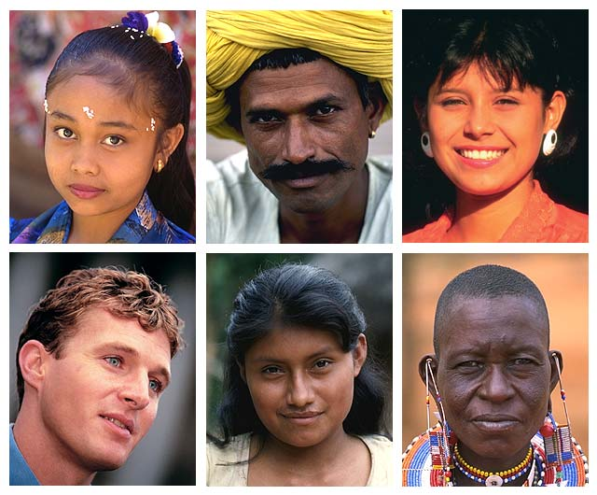
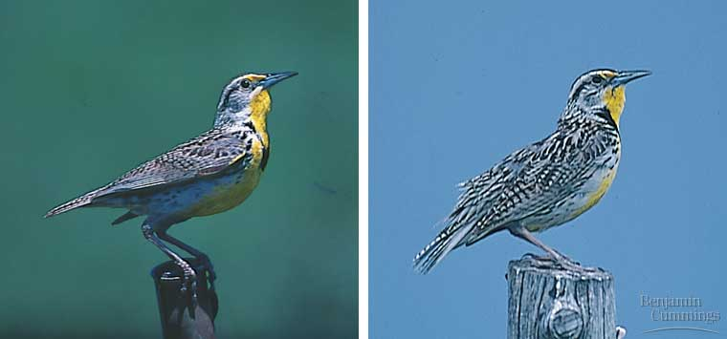
Sooo... What is a species?
Species – population whose member can interbreed and produce fertile offspring
Distinct species:
songs & behaviors are different enough to prevent interbreeding
Notes:
Humans are so diverse but considered one species, whereas these Meadowlarks look so similar but are considered different species.
Meadowlarks
Similar body & colorations, but are distinct biological species because their songs & other behaviors are different enough to prevent interbreeding

Slide 23
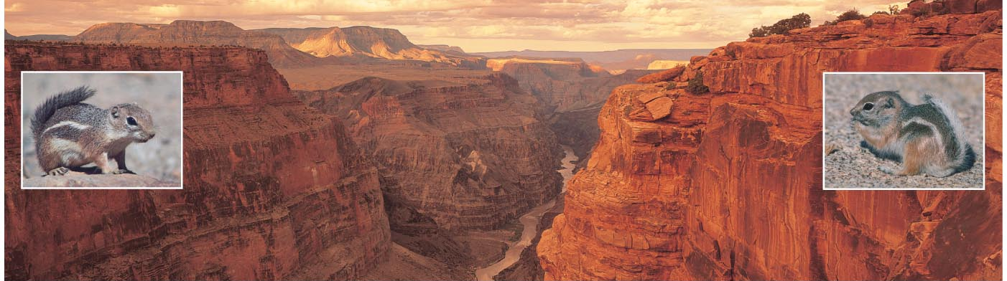
How and Why do New Species Form?
Species are created by a series of evolutionary processes
  Populations become isolated, allowing them to evolve independently
    Geographically isolated
    Reproductively isolated

Slide 24
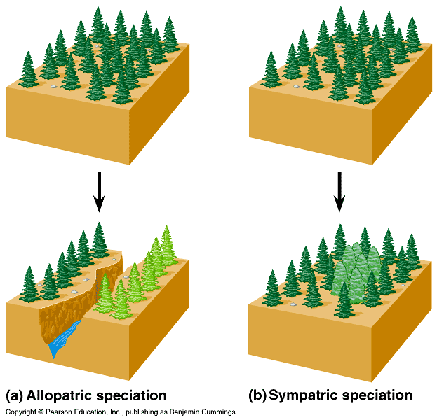
Speciation
Notes:
Allopatric – Geographical split
Sympatric – 2 species from same ancestor that occupy the same location (insects dependent on different host plants)

Slide 25
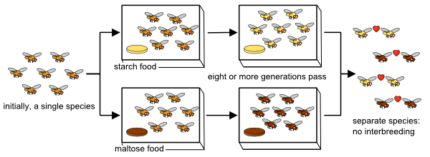
Speciation cont’d

Slide 26
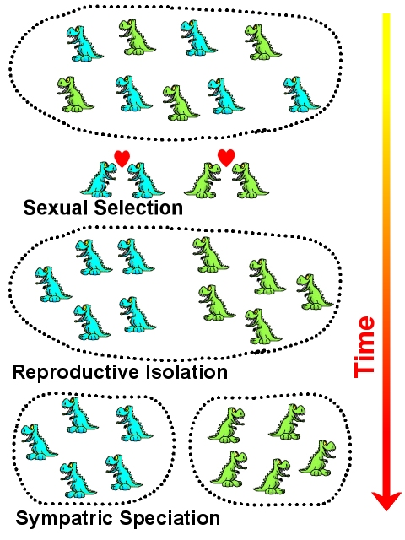
Speciation cont’d

Slide 27
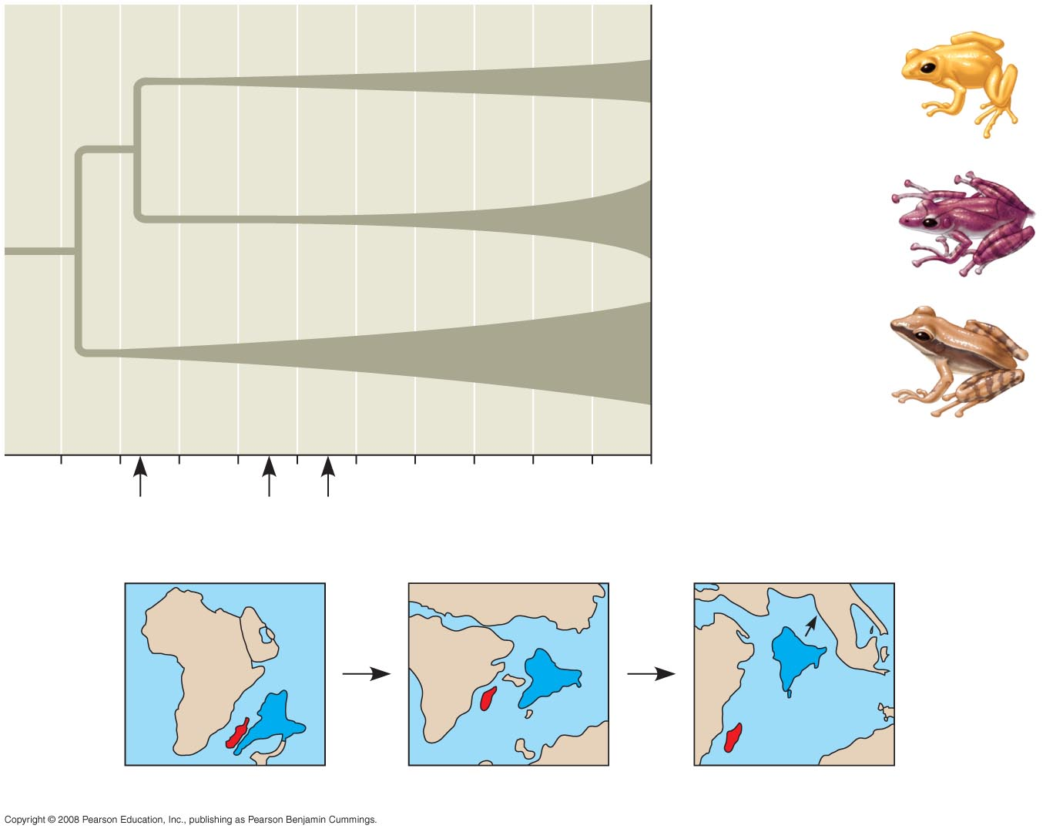
Mantellinae
(Madagascar only):
100 species
Rhacophorinae
(India/Southeast
Asia): 310 species
Other Indian/
Southeast Asian
frogs
100
80
60
40
20
0
1
Millions of years ago (mya)
India
Madagascar
88 mya
65 mya
56 mya
Notes:
Allopatric speciation in frogs
Regions with many geographic barriers typically have more species than do regions with fewer barriers

Slide 28
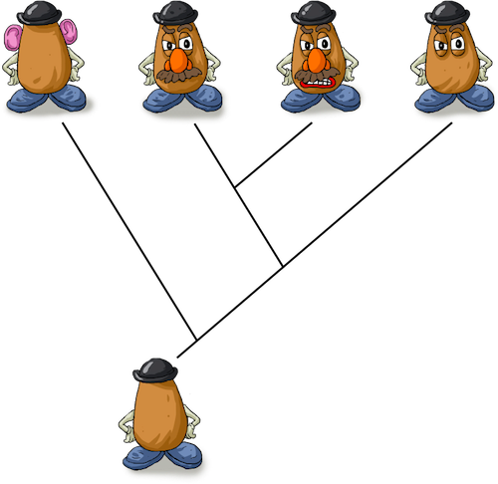
Building “Family” Trees
Closely related species share the same line of descent until their split from a common ancestor

Slide 29
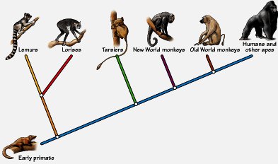
Building “Family” Trees

Slide 30
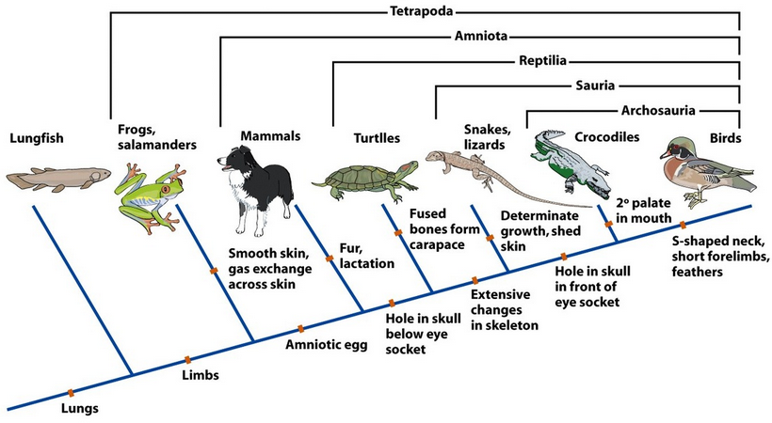
When new species are formed, they share some characteristics with their ancestors and with other organisms that have the same ancestor
We use phylogenic trees to show patterns of descent

Slide 31
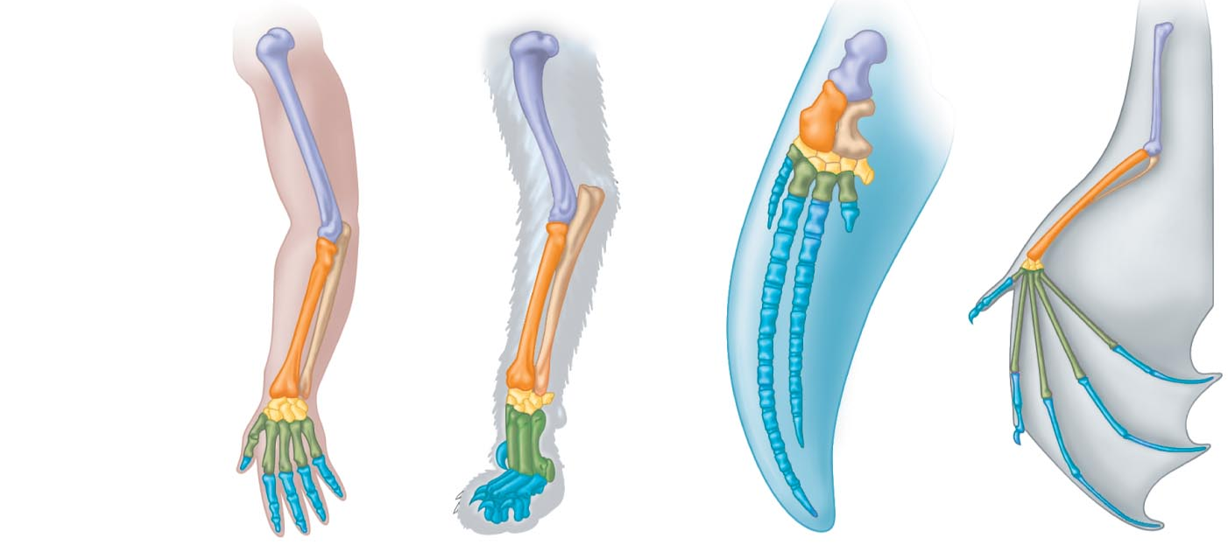
Homologous Structures
Similar structures
Similar development
Different functions
Evidence of close evolutionary relationship
(recent common ancestor)
Humerus
Radius
Ulna
Carpals
Metacarpals
Phalanges
Cat
Whale
Bat
Human

Slide 32
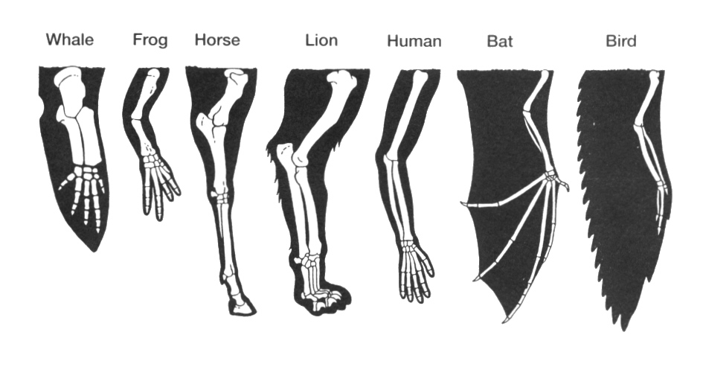

Slide 33
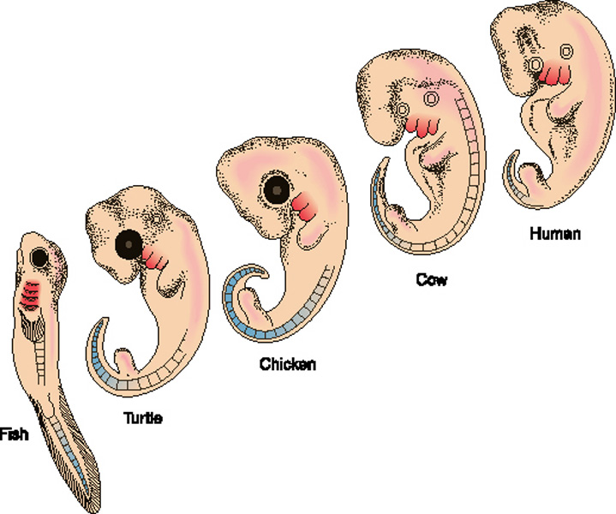
Homologous Structures in Embryos
Comparing embryos can reveal anatomical homologies not visible in adult organisms

Slide 34
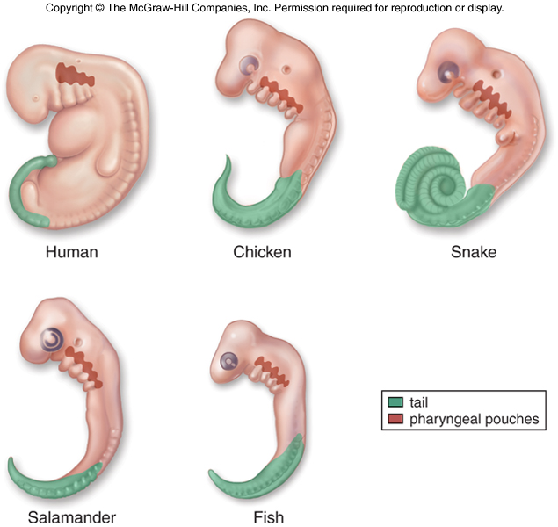
Homologous Structures in Embryos

Slide 35
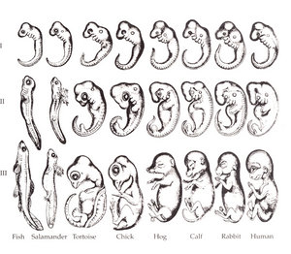

Slide 36
Analogous Structures
Separate evolution of structures
  Similar functions
  Similar external form
  Different internal structure and development
  Different origins
  No evolutionary relationship
Don’t be fooled
by their looks!
Solving a similar problem with a similar solution

Slide 37
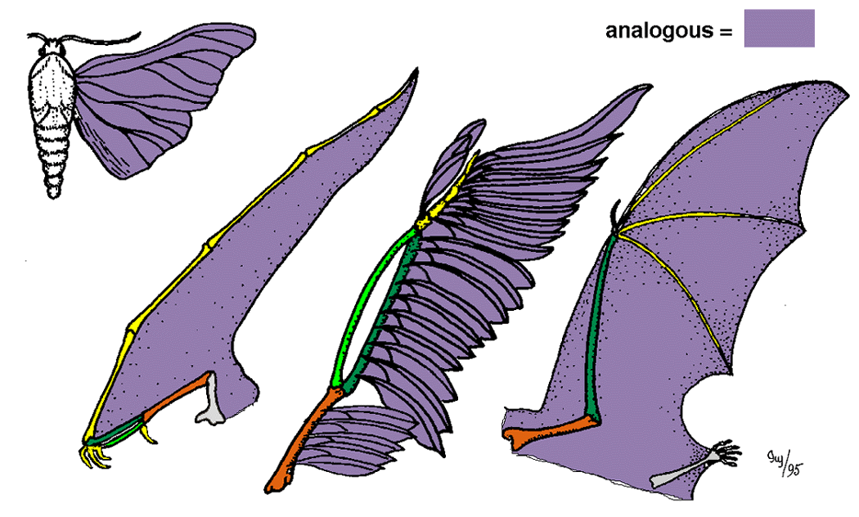
Analogous Structures
Flight evolved in 3 separate animal groups
Does this mean
they have a
recent common
ancestor?

Slide 38
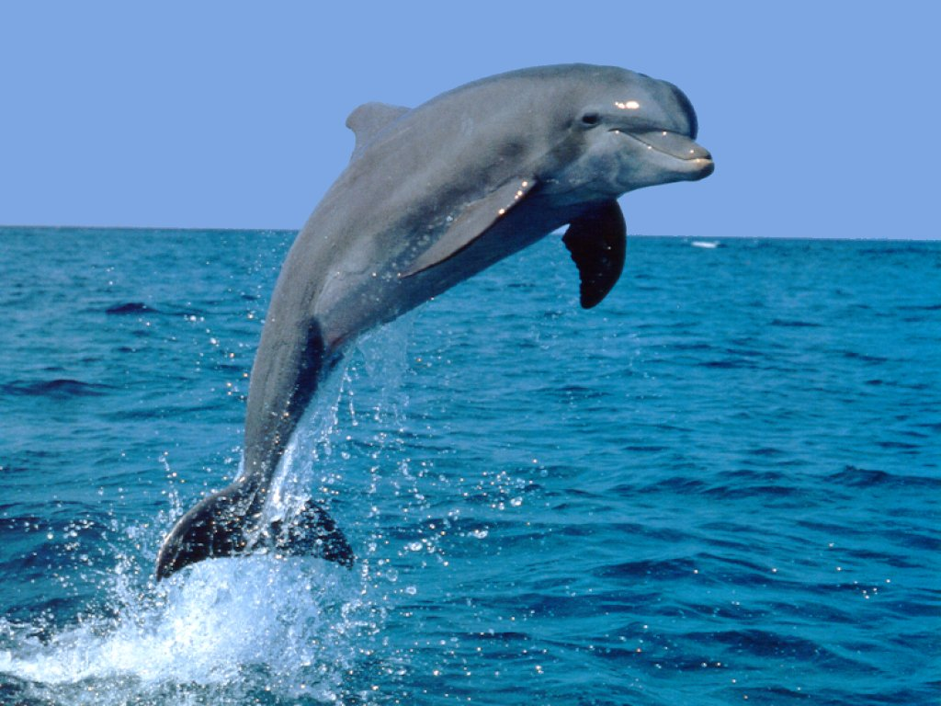
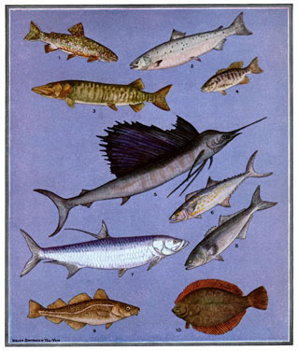
Analogous Structures
Fish – aquatic vertebrates
Dolphins – aquatic mammals
Both have fins and tails and slippery bodies (analogous structures!) but they are not closely related

Slide 39
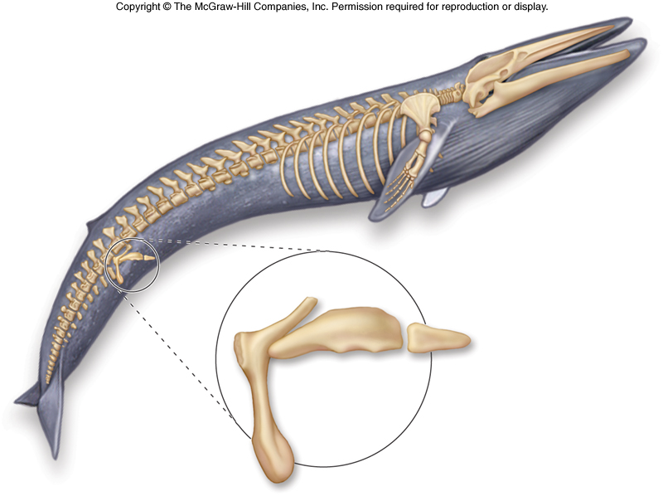
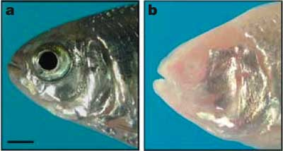
Vestigial Organs
Structures that serve little or no function
  Leftovers of structures that were functional in ancestral species
    Snakes and whales – remains of pelvis and leg bones
    Humans – tail bone, muscles to wiggle our ears
    Blind cave fish – have eyes
    Manatees – fingernails on their fins

