Slide 1
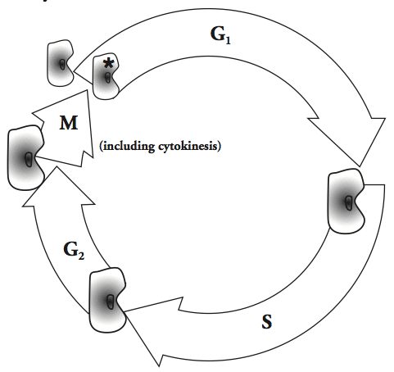
Name _________________________ Date _________
Concept Covered: The Cell Cycle
Name _________________________ Date _________
Concept Covered: The Cell Cycle
Model 1 - The Cell Cycle
Model 1 - The Cell Cycle
How many phases are in the cell cycle as shown in the diagram above?
Starting at the starred cell, what is the order of the stages of a cell’s life?
During which phase does the size of the cell increase?
During which phase does the number of cells increase?
How many phases are in the cell cycle as shown in the diagram above?
Starting at the starred cell, what is the order of the stages of a cell’s life?
During which phase does the size of the cell increase?
During which phase does the number of cells increase?
Copyright © Science Stuff
Copyright © Science Stuff

